Slide 1
CMS-1500 Online Claims Entry
Conduent
Government Healthcare Solutions

Slide 2
Purpose
The purpose of this workshop is to provide an overview of the CMS-1500 direct data entry claims submission process via the New Mexico Medicaid Web Portal. Having an understanding of CMS-1500 direct data entry will improve billing practices by reducing claim denials and ensuring all rendered services are billed properly.

Slide 3
Objectives
Review the following processes regarding CMS-1500 claim submissions:
Claim Form Instructions
Timely Filing
Add/Manage Templates
Medicaid Primary Claims
Medicaid (TPL) Third Party Liability and PPO/HMO Claims
Medicare Replacement Plan Claims
Medicare Primary Claims

Slide 4
Getting Access to Bill on the Web Portal
If you are currently not registered on to the New Mexico Medicaid Web Portal you can create an account using either your active New Mexico Medicaid Provider ID or your NPI using the following link: https://nmmedicaid.portal.conduent.com/webportal/webRegistration/webRegStart
If your New Mexico Provider ID or NPI is currently registered on the New Mexico Medicaid Web Portal but you do not have access to log in to the Web Portal please contact your Master Administrator.
If you do not know if your Provider ID or NPI is registered on the New Mexico Medicaid Web Portal or if you do not know who your Master Administrator is, you can contact the Consolidated Customer Service Center Helpdesk for further assistance at 1-800-299-7304 or by email at HIPAA.desknm@state.nm.us.

Slide 5
Claim Form Instructions
Conduent
Government Healthcare Solutions

Slide 6
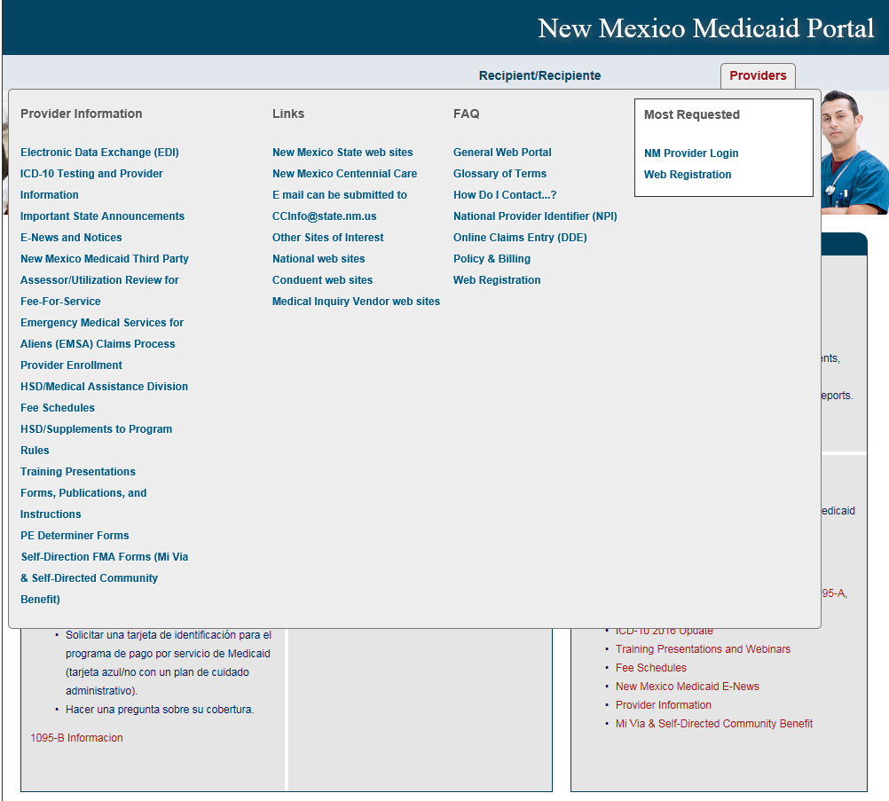
Where Do I Get a Copy of Claim Form Instructions?
On the WEB PORTAL: Click Providers then Forms, Publications, and Instructions under Provider Information
Continued on next screen…
Notes:
In the event paper submission is needed.

Slide 7
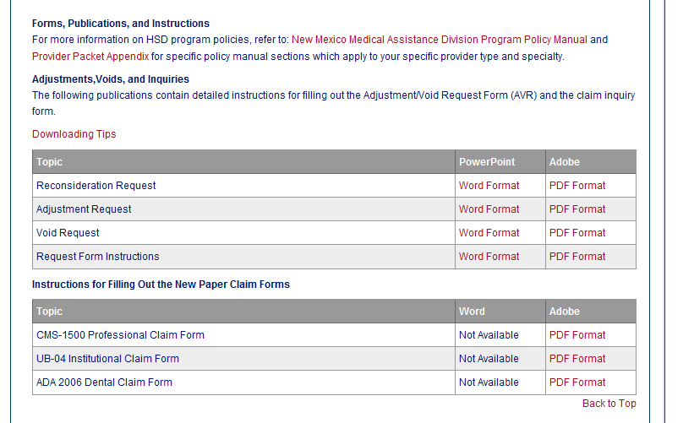
Where Do I Get a Copy of Claim Form Instructions?
Scroll down
Open file

Slide 8
What is a Transaction Control Number (TCN)?
91704900085000001
The twelfth digit in an adjustment/ void TCN will either be:
1= Debit
2= Credit
The first digit indicates what the claim “media” is:
2 = electronic crossover
3 = other electronic claim
4 = system generated claim or adjustment
8 = paper claim
9 = Web portal claim entry
Batch number
The last two digits of the year the claim was received
The numeric day of the year.
The claim number within the batch.
This is the Julian Date - this represents the date the claim was received by Conduent: this claim was received the 49th day of 2017, or February 18, 2017
Notes:
Global slide – indicate somehow

Slide 9
Timely Filing
Conduent
Government Healthcare Solutions

Slide 10
Timely Filing
The information for Timely Filing is found on page 4 under the 8.302.2.11 portion section A. (3):
http://www.hsd.state.nm.us/uploads/files/Providers/New%20Mexico%20Administrative%20Code%20Program%20Rules%20and%20Billing/NMAC%20Program%20Rules/Chapter%20302/8_302_2(3).pdf
The rule can also be accessed via: http://www.hsd.state.nm.us/providers/rules-nm-administrative-code-.aspx
Notes:
Explain outline of PPT.

Slide 11
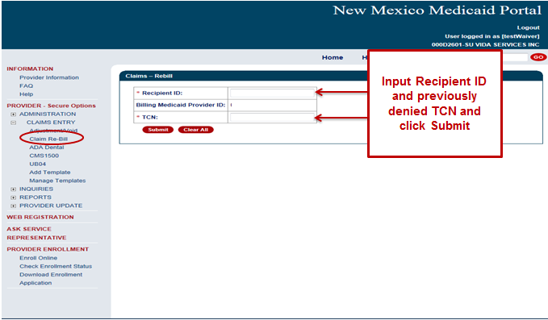
Timely Filing
Re-billing Claims can be done via the NM Web Portal only with claims that were originally submitted via the Portal.
To re-bill a denied claim, click Claim Re-bill under “Claims Entry” when you are logged in to your account.
Re-billing allows you to submit a corrected claim for a denied claim as long as the re-billed claim is submitted within 90 days from the denial of the original claim, not to exceed 210 calendar days from the date of service. When re-billing, you will need to use the TCN from your original claim as your proof of timely filing.
Notes:
If you have claims that were submitted within the 90 day limit from the primary insurance’s payment date but denied for timely filing due to the 210 day final filing limit policy AND you have proof the claims were submitted to the primary insurance within 90 days of the date of service AND either a delay in processing the claim or appeals and reconsideration requests caused the claim to exceed the 210 day final filing limit the claims can be resubmitted with a reconsideration request.

Slide 12
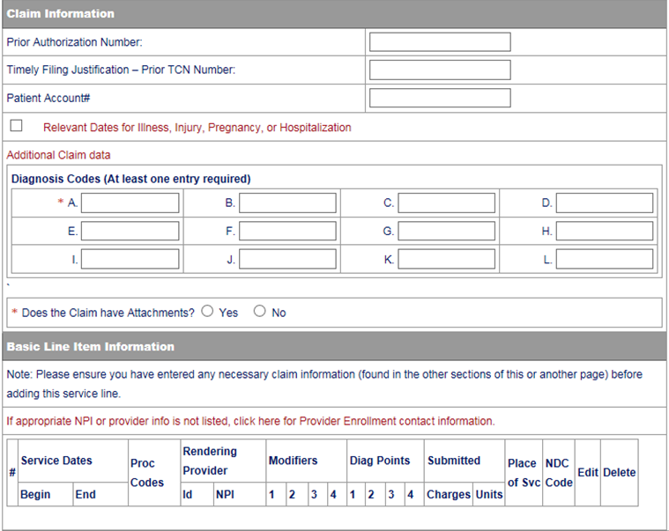
Timely Filing Continued
Indicate the TCN in the “Timely Filing Justification – Prior TCN Number” field.
Notes:
Important Note: Remittance Advices are not considered proof of timely filing.

Slide 13
Add/ Manage Templates
Conduent
Government Healthcare Solutions

Slide 14
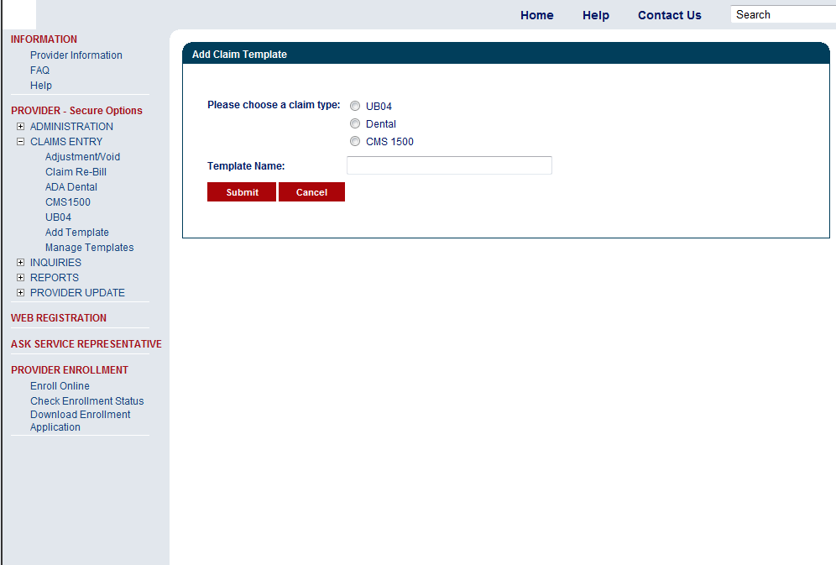
CMS 1500 – Create a Claim Template
Please Note: Templates are limited to 25 per user.
The best time to directly enter your claim is Sunday through Friday between the hours of 6 a.m. - 6 p.m. (MST). Claims entered by Friday 6 pm could be adjudicated and reflect as early as Monday on your Remittance Advice.

Slide 15
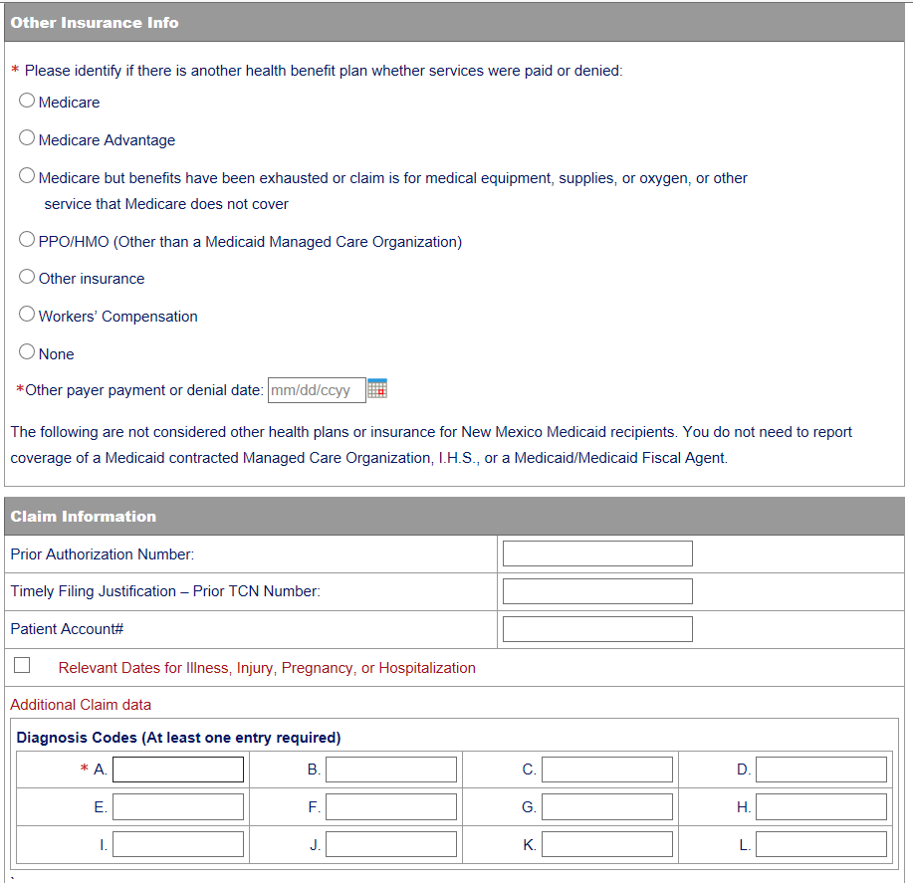
CMS 1500 - Add Claim Template
Fill out any information you would like included in your template

Slide 16
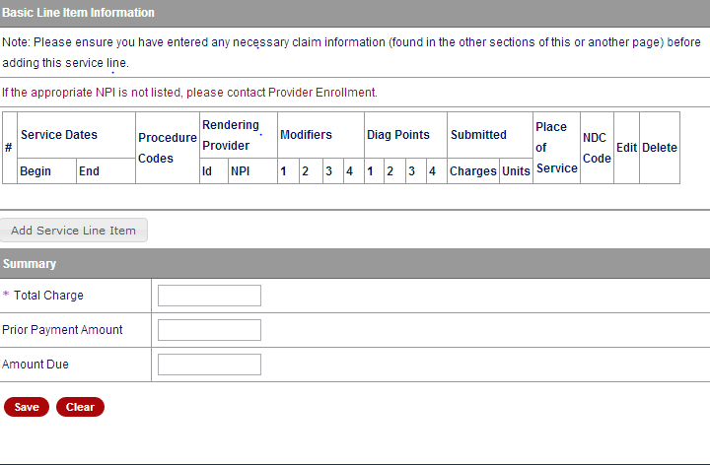
CMS 1500 - Add Claim Template
Fill out any information you would like included in your template

Slide 17
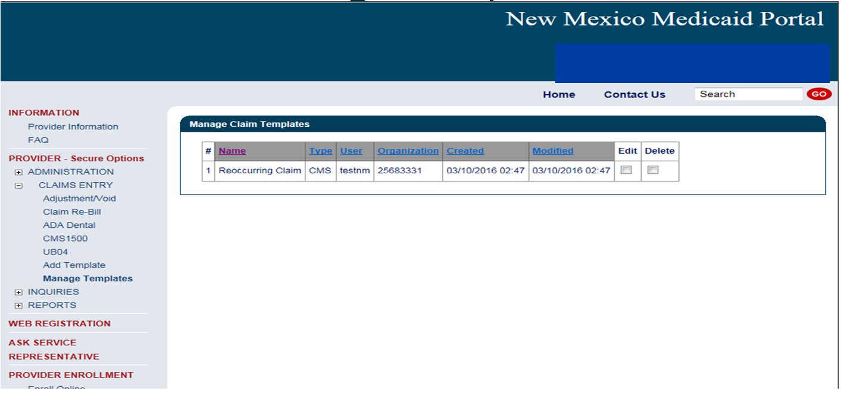
CMS 1500 Manage Templates
Here is where you Edit and/or Delete any information on your claim template

Slide 18
Medicaid Primary Web Portal Claim Submission
Conduent
Government Healthcare Solutions

Slide 19
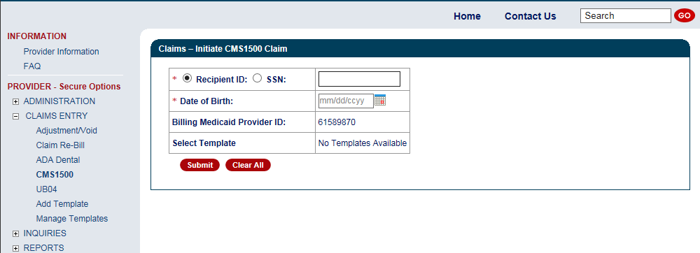
Online Claims Entry
Fields with Red asterisks (*) are required information

Slide 20
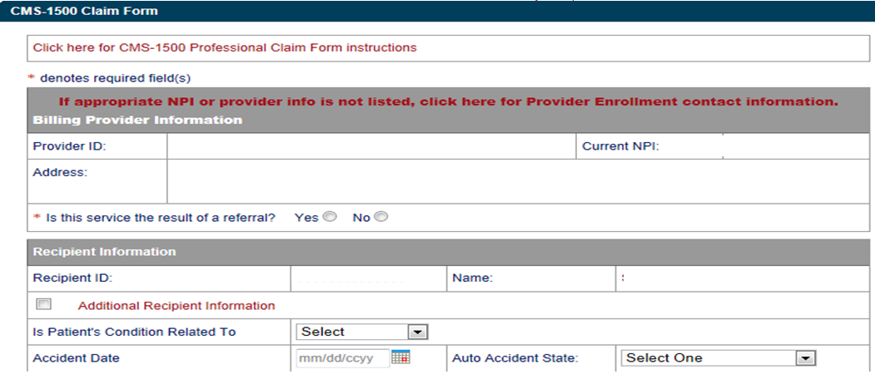
Online Claims Entry Primary Claim Continued
Click on the RED text for the CMS 1500 Claim form instructions

Slide 21
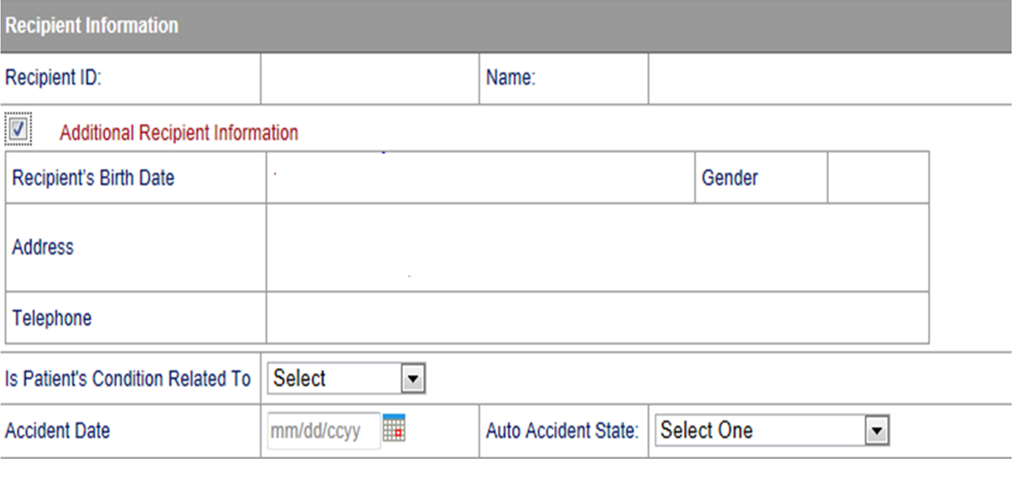
Additional Recipient Information Option
Sections can be expanded by selecting all sections with Red Text
Select “Additional Recipient information” if Patient Condition information is needed to process claim.

Slide 22
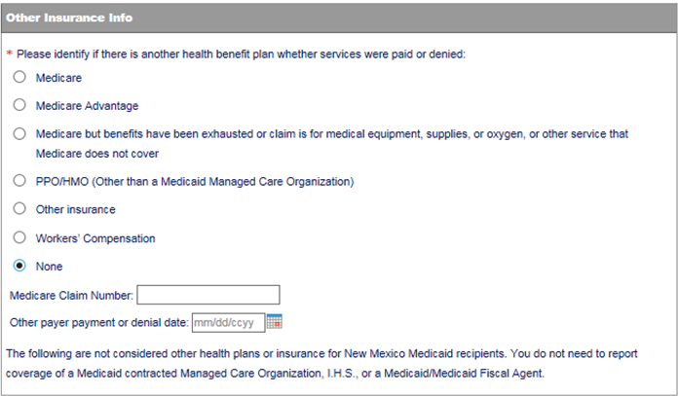
Medicaid Primary Claim Forms
Identify if another heath benefits plan paid or denied, click the corresponding radio button

Slide 23
Claims Information
Sections can be expanded by selecting all sections with red text.

Slide 24
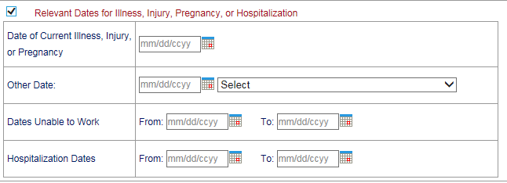
Claims Information – Relevant Dates
Expanded ‘Relevant Dates” Section

Slide 25
Claims Information – Attachments
From the ‘Select’ drop down, pick the correct attachment type you are adding to the claim

Slide 26
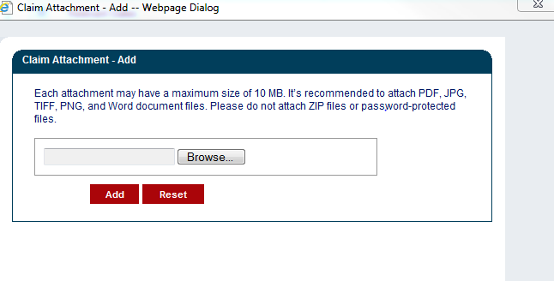
Claims Information – Attachment Upload
Review the Uploading Attachments Restrictions.
You can attach files up to 10 MB in size
Do not upload ZIP Files, Excel Spreadsheets or Password Protected Files. PDF, JPG, TIFF, and Word Documents files are recommended

Slide 27
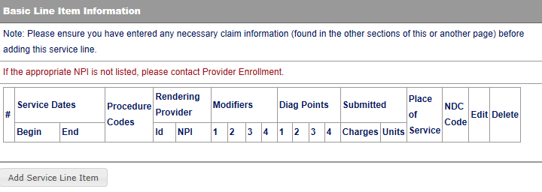
Line Item Information
Click to add Line Items

Slide 28
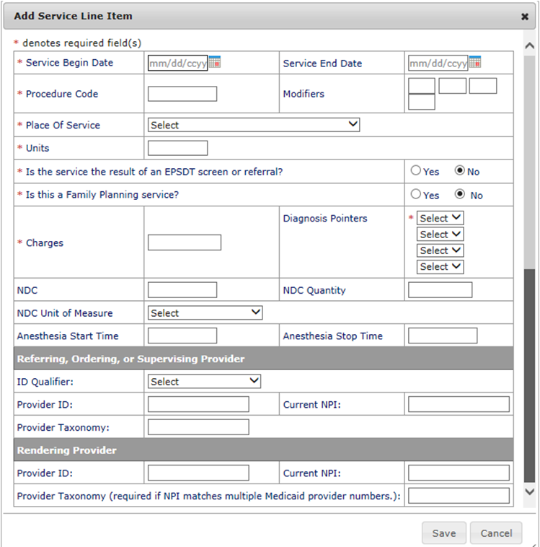
Adding Additional Line Item Information
The fields with Red Asterisks (*) are REQUIRED

Slide 29
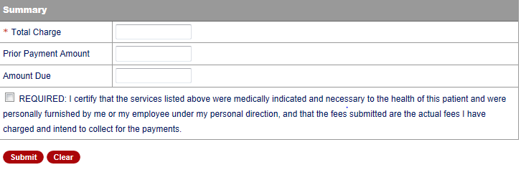
Claims Summary
Indicate the Total Charge
Indicate the Amount Due
X
Box must be populated in order for claim to be submitted
Notes:
NO enforcement on the data entered into the Summary fields.

Slide 30
TPL, HMO, and PPO Web Portal Claim Submission
Conduent
Government Healthcare Solutions

Slide 31
Other Primary Insurance Tips
If Medicaid requires a Prior Authorization (PA) for the service, then a PA issued by the Medicaid Third-Party Assessor (TPA) is always required when Third Party Liability (TPL ) is involved, no matter if TPL paid or denied the service.
Attach the TPL EOB showing the payment/denial with the claim.
Always include the explanation page of the EOB along with the page of the EOB that shows payment/denial.
PPO/HMO claims are billed identically to “other insurance” (TPL) claims.

Slide 32
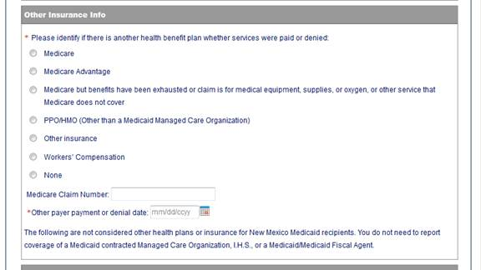
TPL, HMO, and PPO Web Portal Claim Submission
When filling out a Medicaid claim indicate whether the Primary Insurance us a PPO/HMO or other insurance by selecting the appropriate option
When filling out a Medicaid claim where TPL is primary payer, be sure to fill in all required primary and secondary payer information

Slide 33
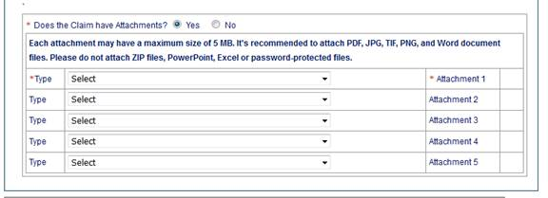
Claims Information – Attachments
Attach a copy of the EOB
along with the explanation
of denials page

Slide 34
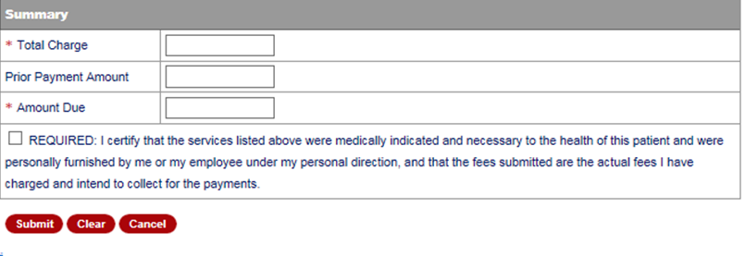
Primary Payer Insurance Information
Other Primary Insurance Payment
Co-pay/Co-insurance/
Deductible/Patient Responsibility
X
Box must be populated in order for claim to be submitted

Slide 35
Medicare Primary Web Portal Claim Submission
Conduent
Government Healthcare Solutions

Slide 36
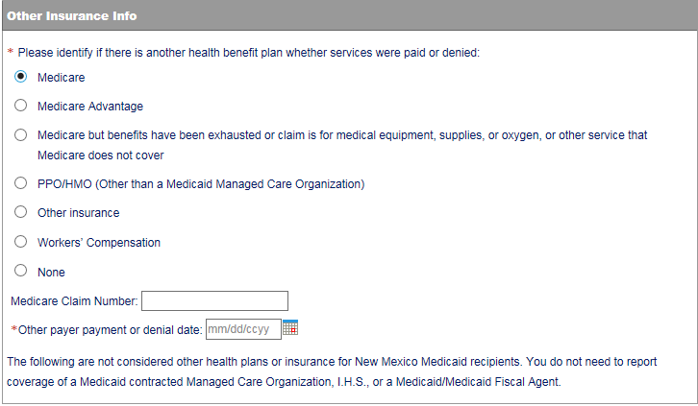
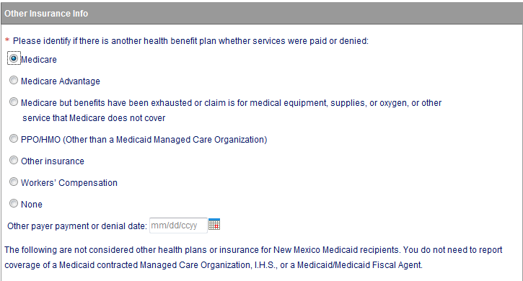
Medicare Primary Claims
Indicate “Medicare” on Medicare Crossover claim OR
“Medicare Advantage” for Medicare Replacement Plan claims

Slide 37
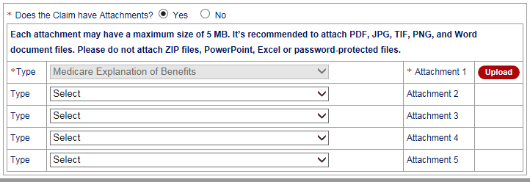
Medicare Primary– Attachments

Slide 38
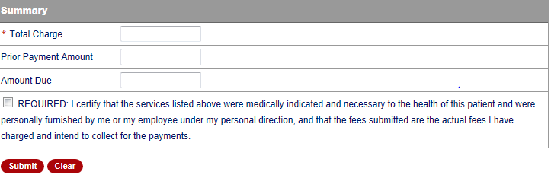
Medicare Primary Claims
Only Indicate Total charge on Medicare Crossover claim
Leave the Prior Payment Amount Blank
Indicate the Amount Due
X
Box must be populated in order for claim to be submitted
Notes:
Speaker Notes: User needs to enter Amount Due or else claim will post a denial edit.

Slide 39
CMS 1500 Tips
Utilize a TCN for proof of Timely Filing
Attach EOBs if other insurance is primary
Attach any required documentation

Slide 40
Summary
Provided general billing guidelines for direct data entry submission of the CMS 1500 claim form for the below coverage scenarios.
Add/Manage Templates
Medicaid Primary Claims
Medicaid Third Party Liability (TPL) Claims
PPO/HMO Claims
Medicare Primary (Crossovers) Medicare Replacement Plan Claims

Slide 41
New Mexico Medicaid Resources
New Mexico Medicaid Online
Provider Information
Provider Login Screen Notices
Provider E-News Newsletters
Medicaid Provider Relations Call Center
Provider Communication Updates
Provider Field Representative
Provider Webinars
Open Forums and Live Training Sessions

Slide 42
New Mexico Medicaid Resources Continued
New Mexico Medicaid Portal – https://nmmedicaid.portal.conduent.com/static/index.htm
Claim Inquiries, Eligibility Verification, Electronic Claim Submission, Provider Manuals, E-News
NM Human Services Department – http://www.hsd.state.nm.us/mad/
Supplements, Memos, Provider Billing Packets and Policy
Consolidated Customer Service Center (CCSC) Helpdesk– (800) 299 - 7304.
Claim Status, Eligibility, Prior Authorization, Medicaid Updates
Consolidated Customer Service Center (CCSC) Helpdesk – NM.Providers@state.nm.us
Claim research assistance, general Medicaid inquiries, Provider Enrollment Applications, Forms & Instructions
HIPAA Helpdesk – HIPAA.desknm@state.nm.us
Assistance on NM Web Portal, EDI inquiries, and Online Claim Submission with DDE (Direct Data Entry)
Consolidated Customer Service Center (CCSC) Helpdesk – (800) 283-4465
Eligibility inquiries, Fee-for-Service Replacement Medicaid Identification Card, Enroll or change a Managed Care Organization and Eligibility application status
Medical Assistance Division, Program Rules – http://www.hsd.state.nm.us/providers/rules-nm-administrative-code-.aspx
NMAC for Programs administered by the Medical Assistance Division Yes New Mexico - https://www.yes.state.nm.us/yesnm/home/index Apply, check, update, or renew Medical Assistance (Medicaid) benefits

